Slide 1
+441315101477

Slide 2

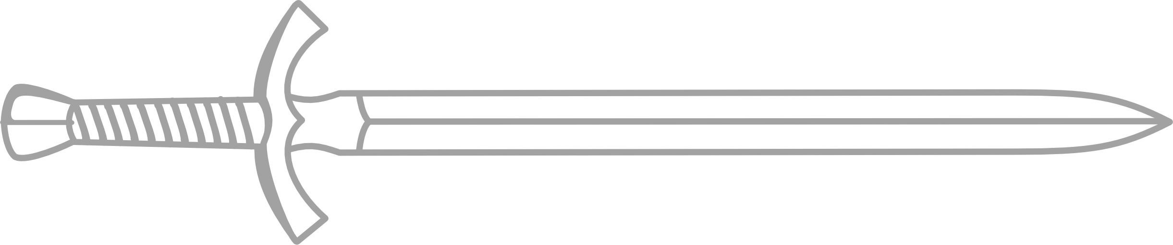
TYR
^

Slide 3

+441315101477

Slide 4
+441315101477

Slide 5

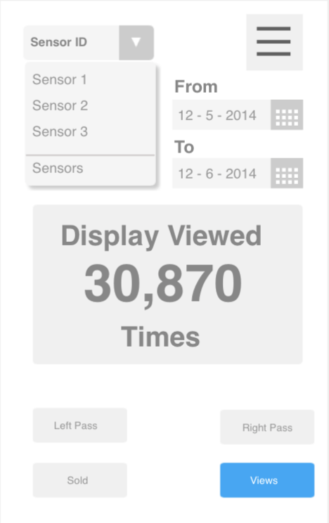
+441315101477

Slide 6

+441315101477

Slide 7
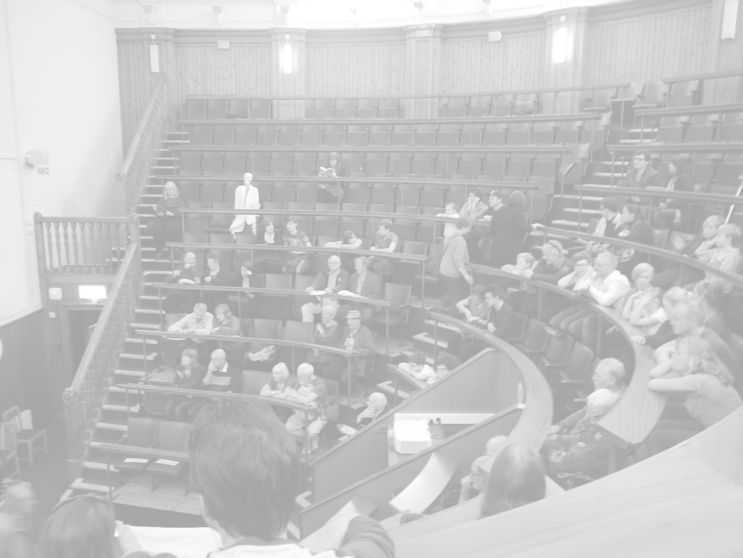
+441315101477

Slide 8
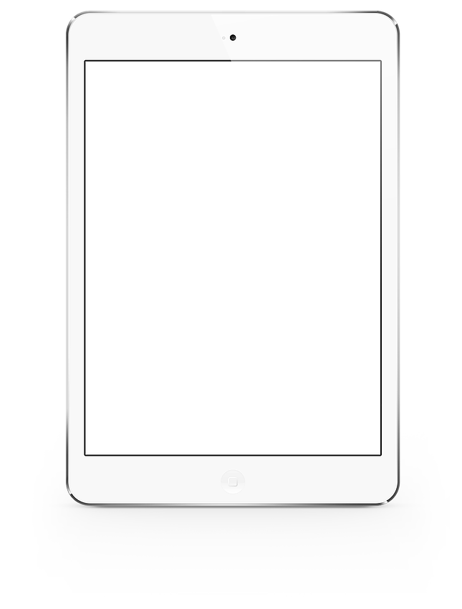
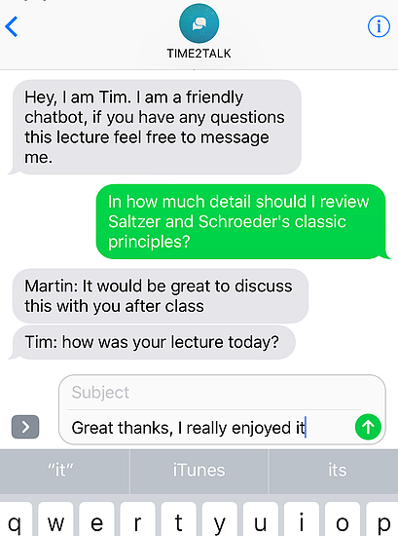
+441315101477

Slide 9
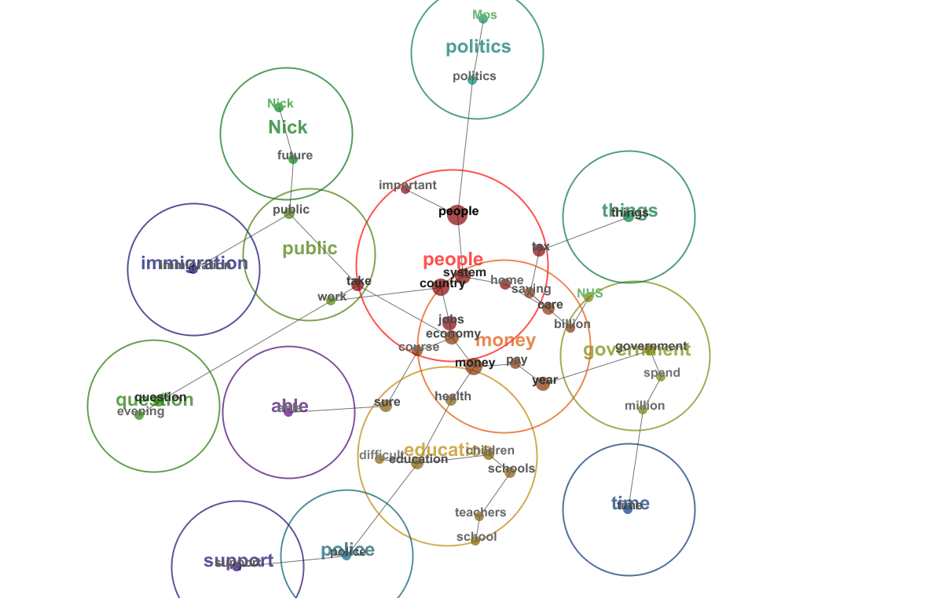
+441315101477

Slide 10
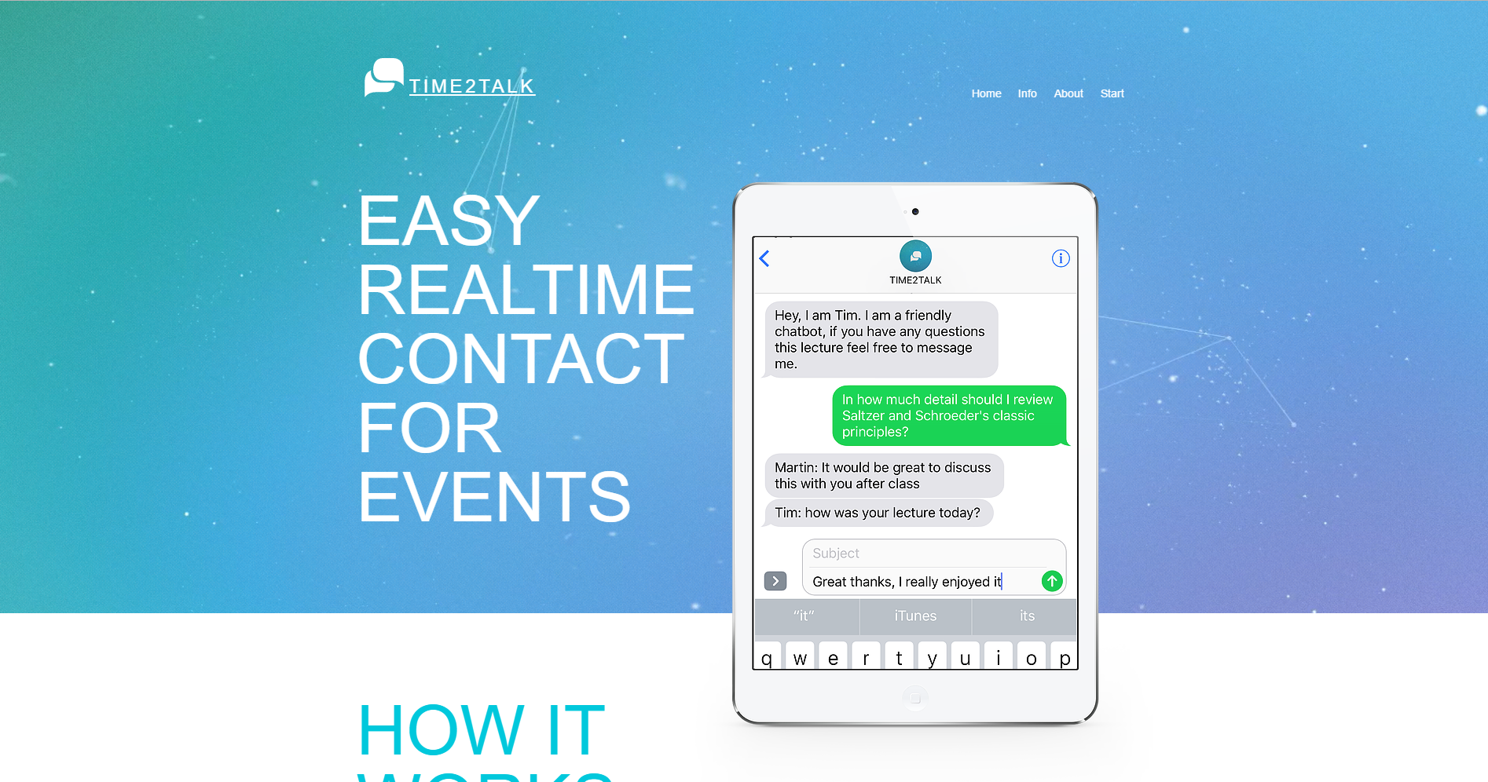
+441315101477

Slide 11
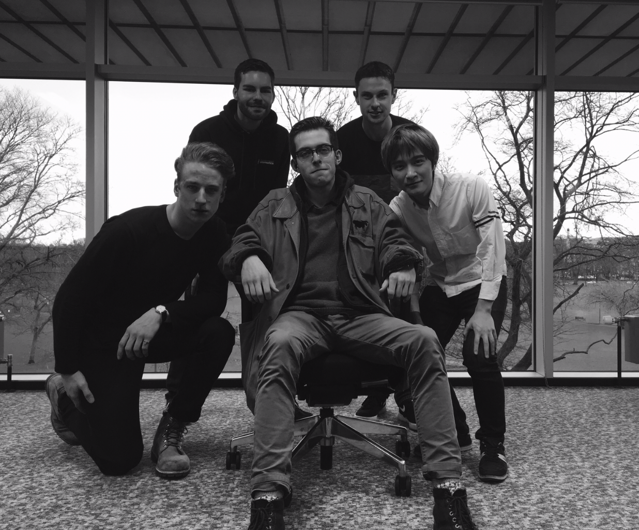
+441315101477

